Slide 1

Building Tesla’s Battery Range Calculator with Vue

Slide 2
Agenda workshop

Slide 3


Component based
Focused on the view layer (all browsers)
Integration with Angular or React
Small and compact (21 Kb)

Slide 4
Virtual DOM Vue.js and React both use virtual DOM, which makes it faster
Notes:
less expensive:
The changes are not made to the DOM, instead a replica of the DOM is created which is present in the form of JavaScript data structures. Whenever any changes are to be made, they are made to the JavaScript data structures and the latter is compared with the original data structure. The final changes are then updated to the real DOM.

Slide 5
root Vue Instance
var app = new Vue({
// options
})
Notes:
To start with VueJS, we need to create the instance of Vue, which is called the root Vue Instance.

Slide 6
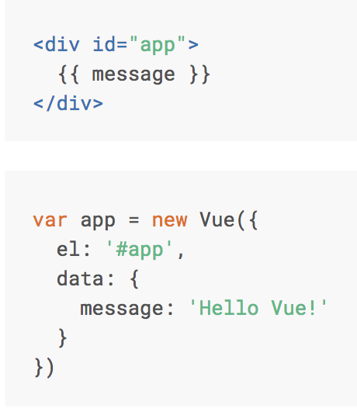

Basics Vue.js
Notes:
For Vue, there is a parameter called el. It takes the id of the div-element.
Next, we have defined the data object. It has a property : message -> value: ‘message’
This will be rendered in the View via ‘interpolation’ {{}}

Slide 7
Interpolation
<span> Message: {{ message }} </span>

Slide 8
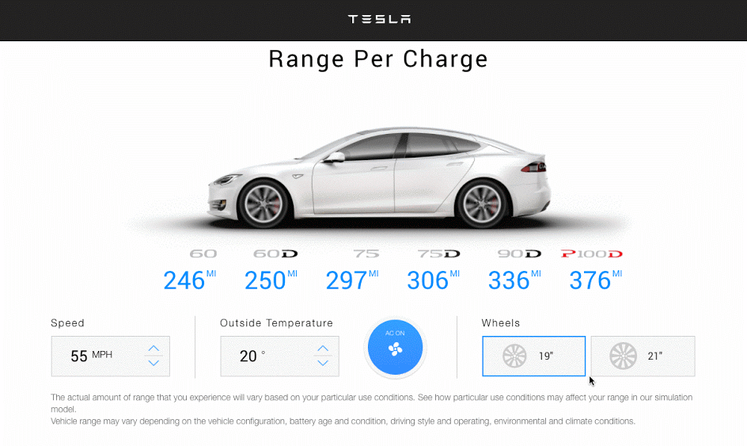

Slide 9
Live version
http://react-tesla-charge-calculator.surge.sh/

Slide 10
Component based A component adds logic to DOM elements
Notes:
Components are one of the important features of VueJS that helps create custom elements, which can be reused in HTML.

Slide 11
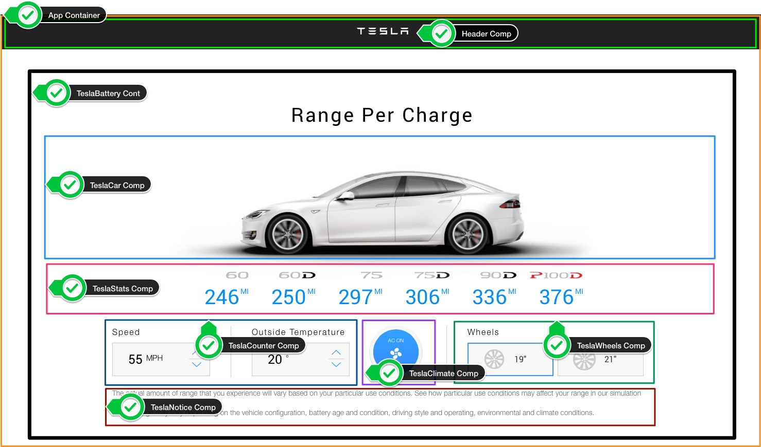

Slide 12
The UI is represented by a component tree
<App> -- Application entry point <TeslaHeader></TeslaHeader> <TeslaBattery> -- Container Component <TeslaCar /> -- Presentational Component <TeslaStats /> -- Presentational Component <TeslaCounter /> -- Presentational Component <TeslaClimate /> -- Presentational Component <TeslaWheels /> -- Presentational Component <TeslaNotice /> -- Presentational Component </TeslaBattery> </App>

Slide 13
Components tree
Main.js
App.vue
TeslaBattery
→ Container Component
props
props
props
props
props
TeslaCar
TeslaStats
TeslaCounter
TeslaClimate
TeslaWheels
Presentational Components

Slide 14
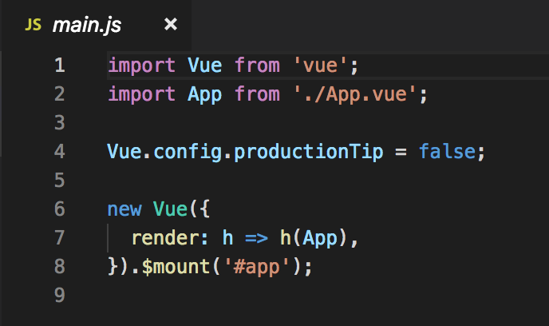
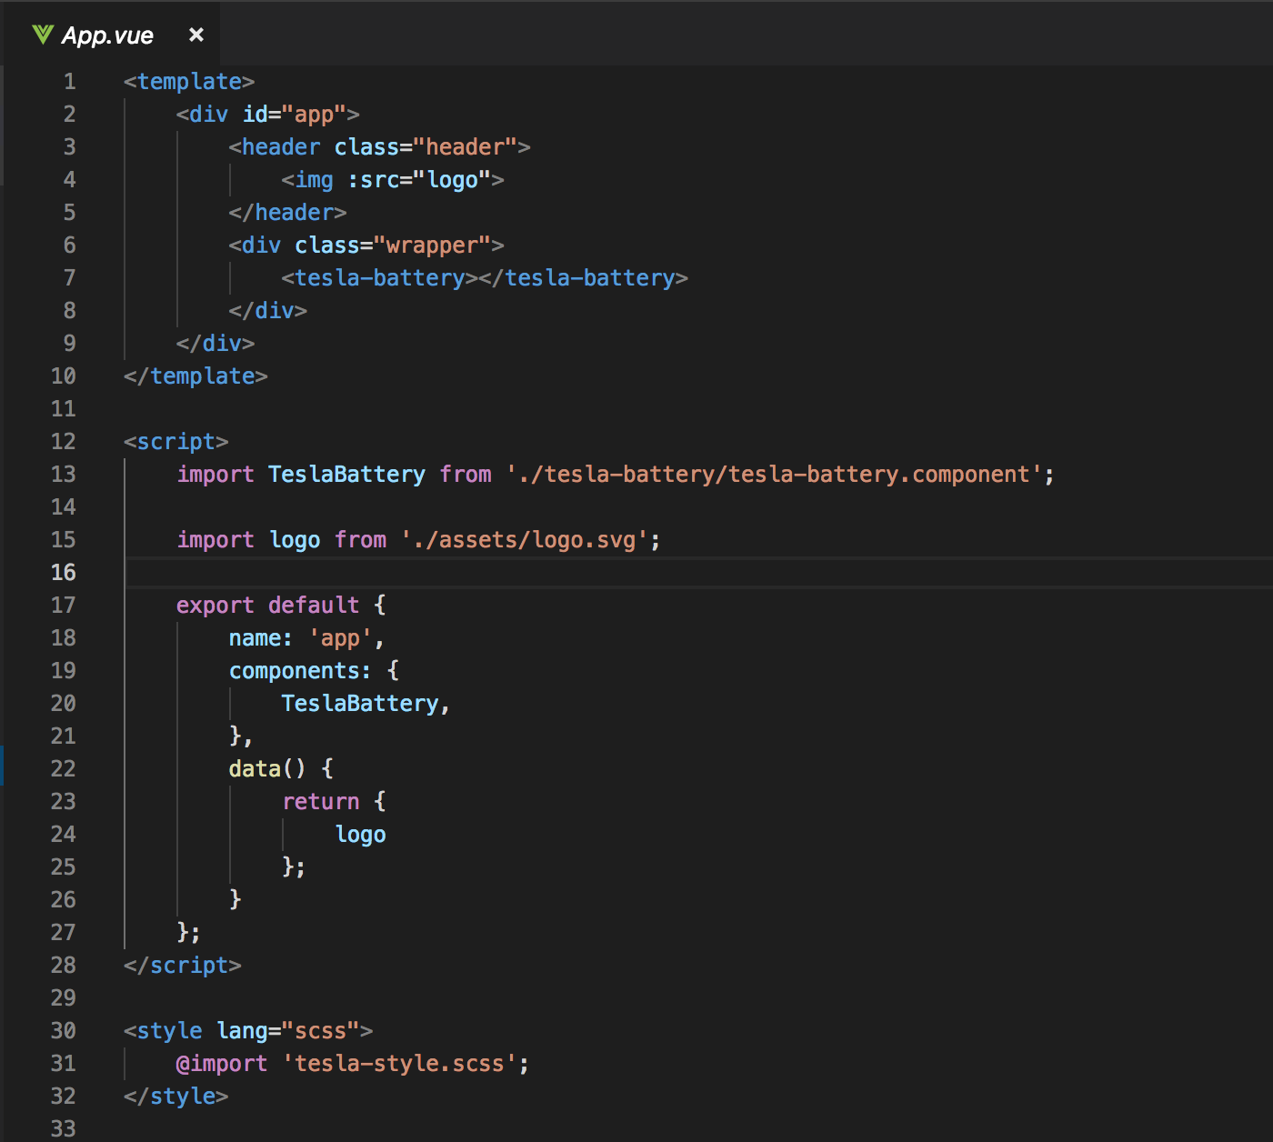
Entry Point
main.js
App.vue

Slide 15
Components tree
Main.js
App.vue
TeslaBattery
props
props
props
props
props
TeslaCar
TeslaStats
TeslaCounter
TeslaClimate
TeslaWheels

Slide 16
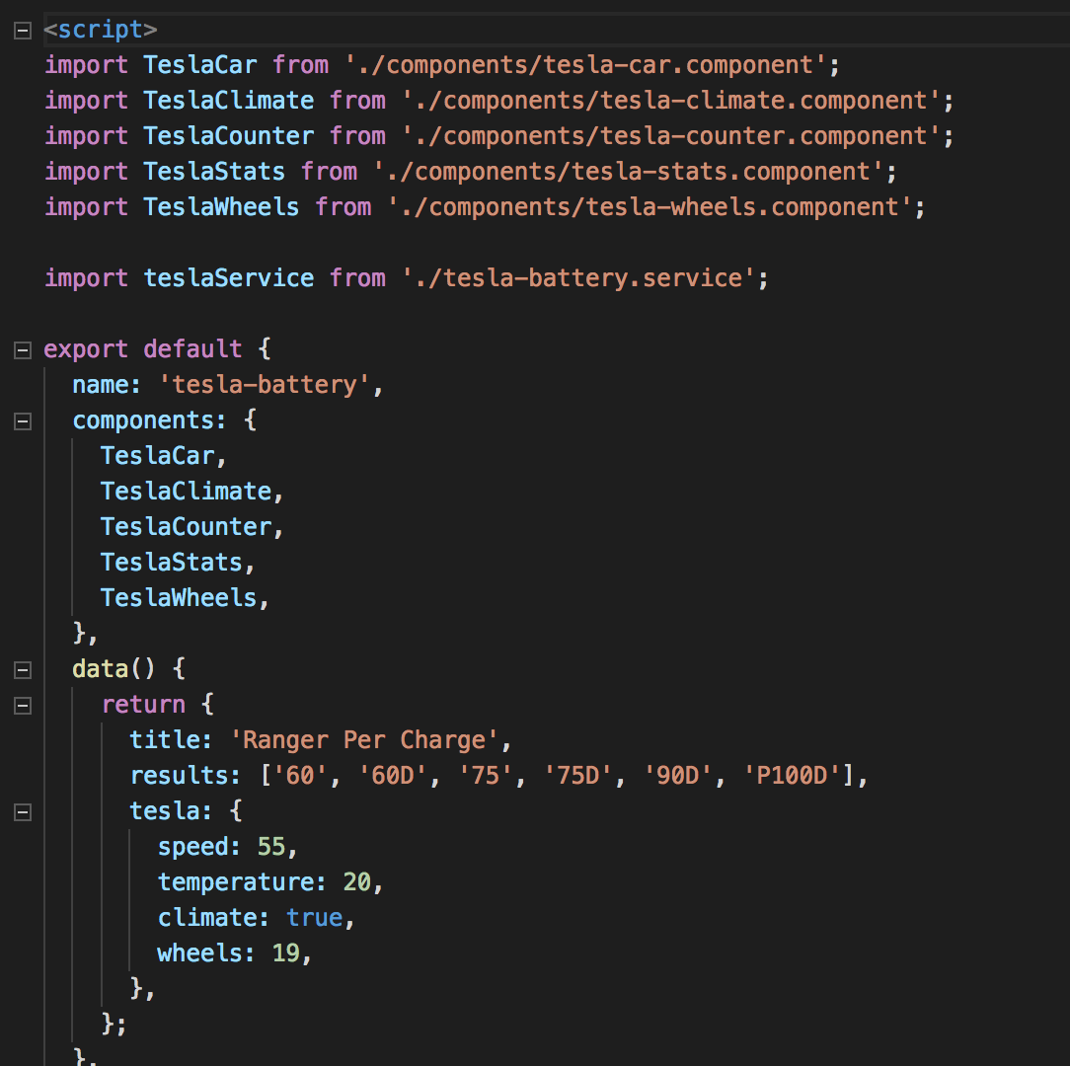
Tesla Battery Component (Container component)

Slide 17
Container Component (stateful component)
Are concerned with how things work.
Provide data and actions to presentational components.
Are often stateful, as they tend to serve as data sources.

Slide 18
Presentational Component (stateless component)
Are concerned with how things look.
Usually have some DOM markup and styles of their own.
Receive data and callbacks exclusively via props.
Rarely have their own state (when they do, it’s UI state rather than data). A presentational Component is stateless

Slide 19
What are the benefits of using these patterns?
Better separation of concerns
Better reusability
Extract layout components to prevent duplication

Slide 20
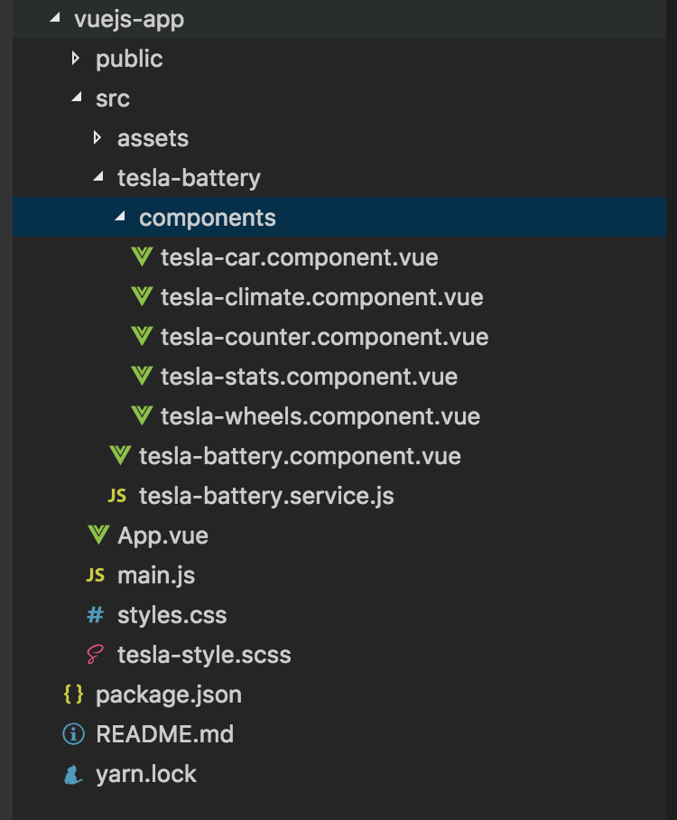

Slide 21
Syntax Component

Slide 22
Data binding
Data binding is the mechanism used to ensure the linking between what a user see on the screen and the data value in our Component.
(View/template <-> Component)

Slide 23
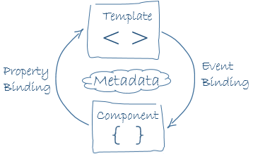
Data binding

Slide 25
How to create a tesla.header.component?
App.vue
props: “greeting”
TeslaHeader
TeslaBattery
props
props
props
props
props
TeslaCar
TeslaStats
TeslaCounter
TeslaClimate
TeslaWheels

Slide 26
tesla-header.component
Step1 Create tesla-header.component.vue
Step 2 Import tesla-header.component in App.vue

Slide 27
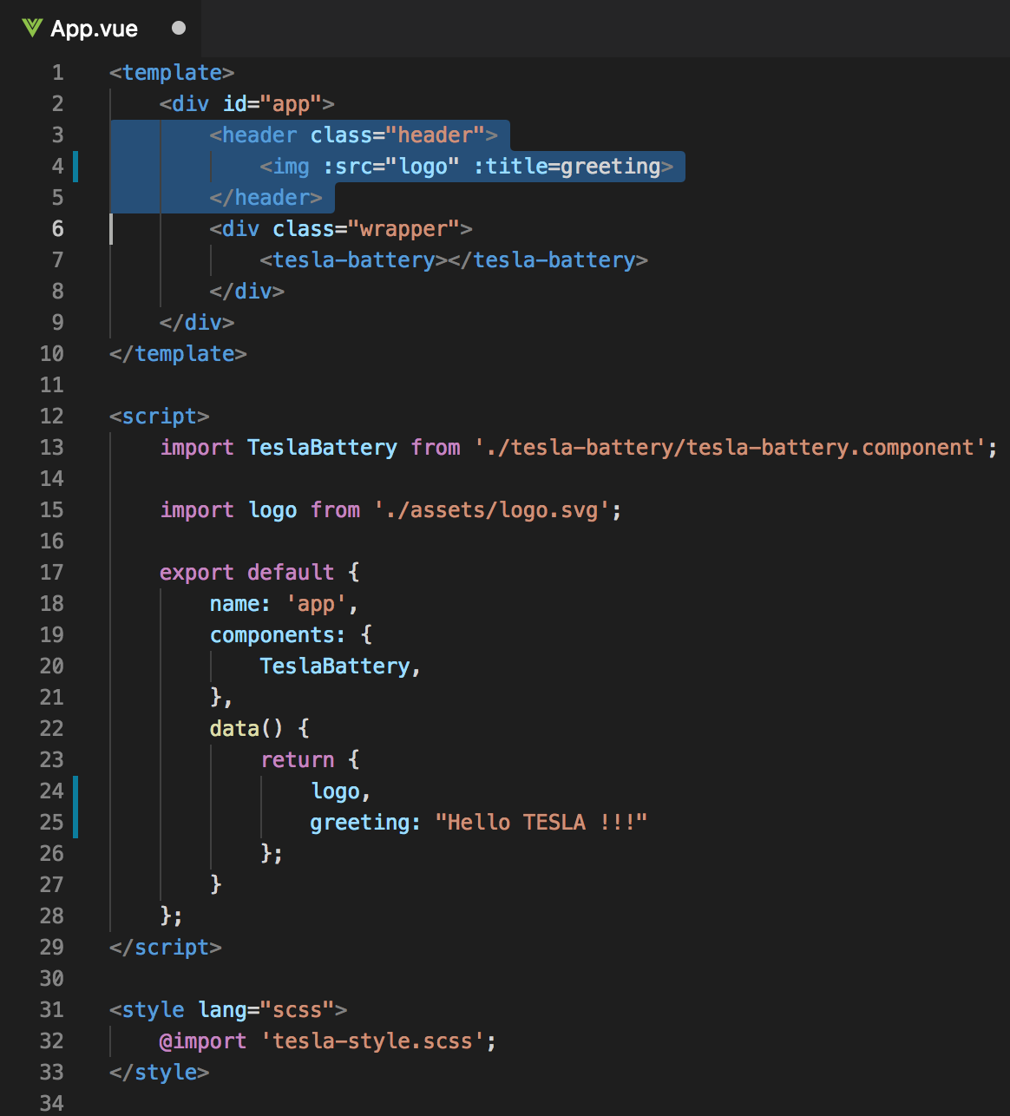
Current App.vue

Slide 28
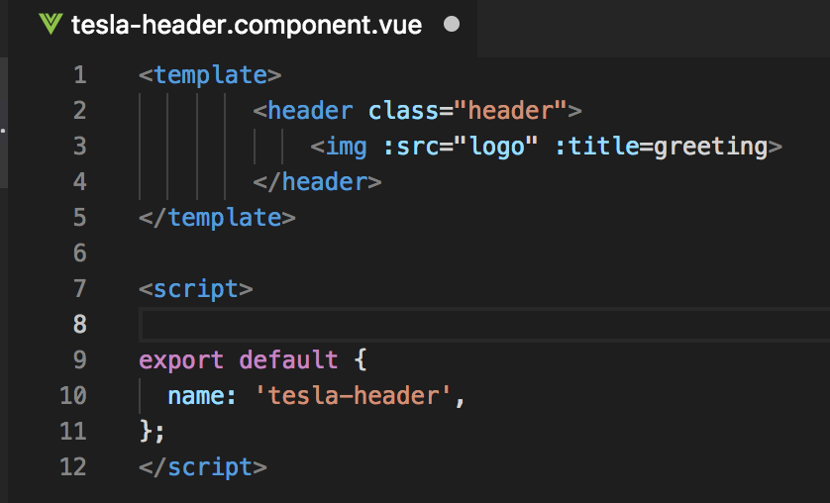
Step1 tesla-header.component.vue

Slide 29
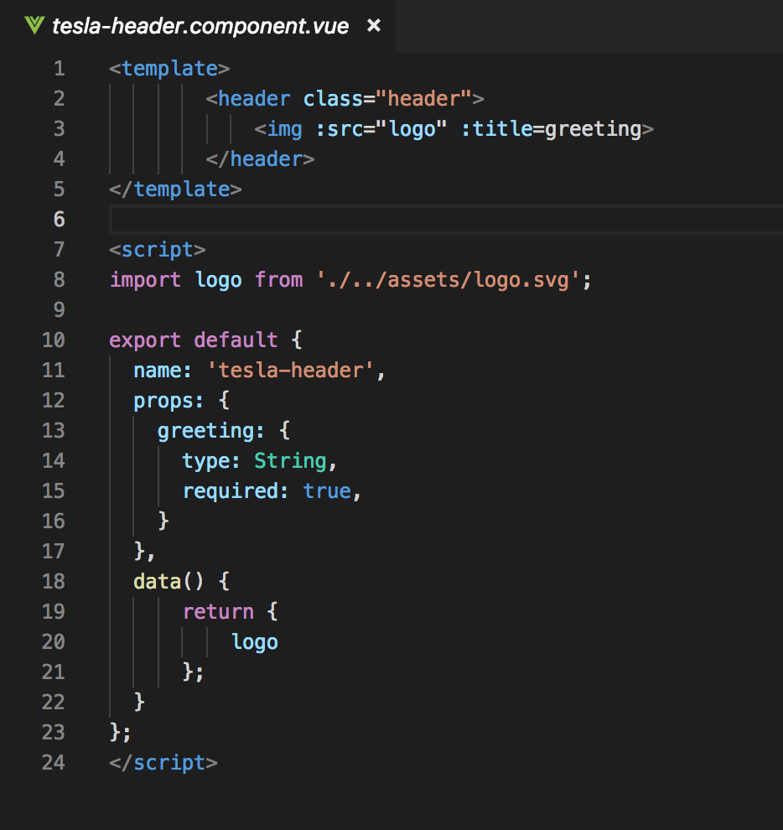
Step1 tesla-header.component.vue
Notes:
Name
Props → logo

Slide 30
Components tree
App.vue
props: “greeting”
TeslaHeader
TeslaBattery
props
props
props
props
props
TeslaCar
TeslaStats
TeslaCounter
TeslaClimate
TeslaWheels

Slide 31
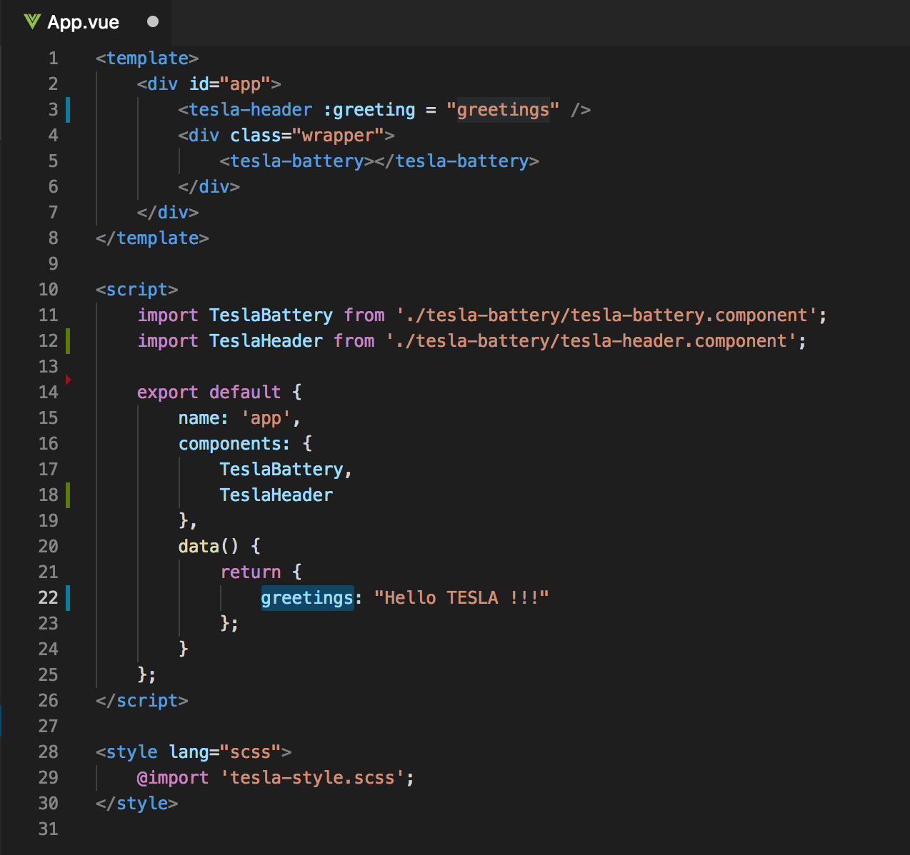
Step 2 Import tesla-header.component in App.vue
Old
New

Slide 32
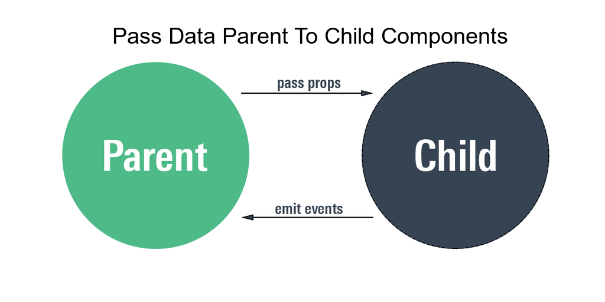

Slide 33
Components tree
App.vue
props: “greeting”
TeslaHeader
TeslaBattery
props
props
props
props
props
TeslaCar
TeslaStats
TeslaCounter
TeslaClimate
TeslaWheels

Slide 34
Pass Props
<tesla-header :greeting= “greetings” />

Slide 35
Emit events
App.vue
props: “greeting”
TeslaHeader
TeslaBattery
emit
props
props
props
props
props
TeslaCar
TeslaStats
TeslaCounter
TeslaClimate
TeslaWheels

Slide 36
Emit events

Slide 37
Tesla Battery Component (Container component)

Slide 38
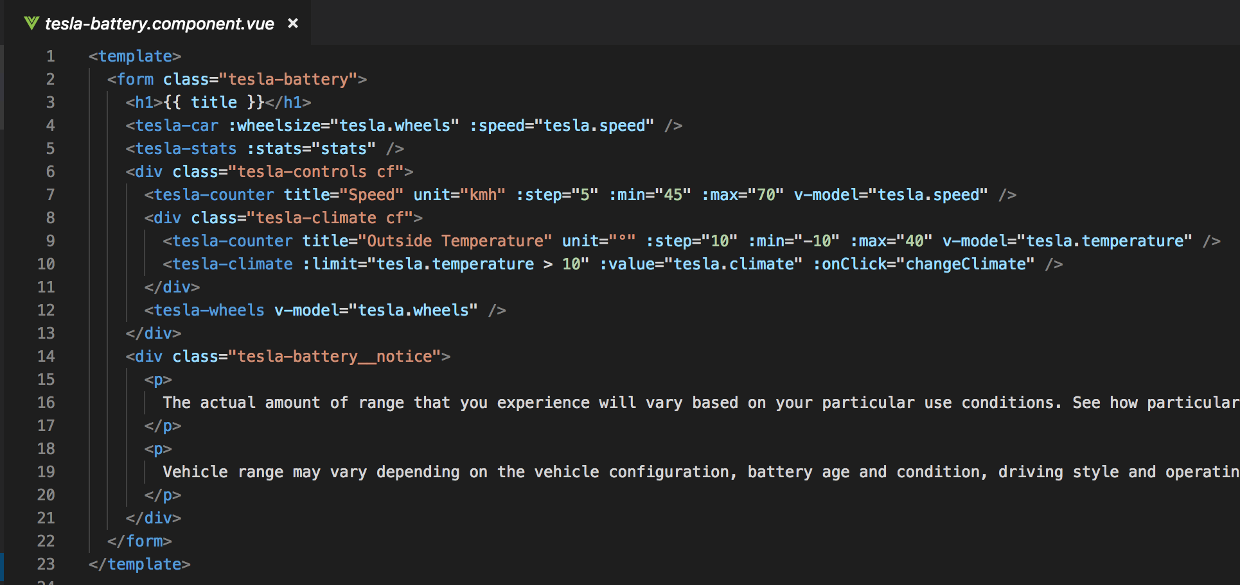
Tesla Battery Component (template)

Slide 39
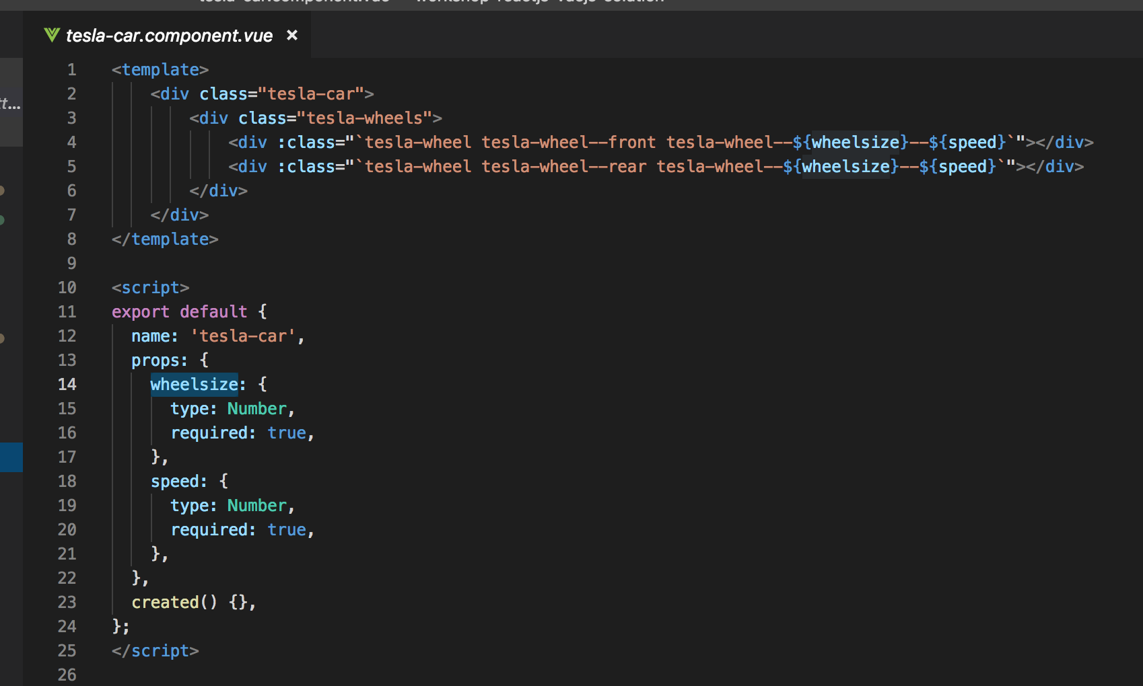
TeslaCar

Slide 40
Data service => TeslaBattery.service
Structure data:
Models –> wheels – climate – speed - temparature
Models = '60', '60D', '75', '75D', '90D', 'P100D'

Slide 41
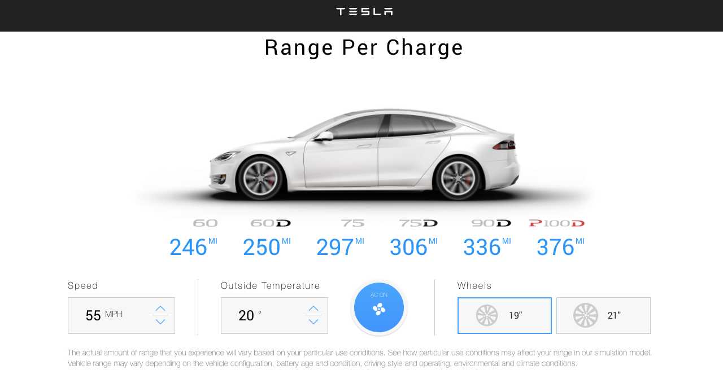
Exercise: check TeslaBattery.service model

Slide 42
Weetjes:
tesla-battery.component → stats()-method (voor het calculceren van de maximale battery range) is called als er een parm veranderd (wheels – climate – speed - temparature)
tesla-battery.component → change parms (wheels – climate – speed - temparature) wordt middle 2-way databinding doorgegeven →zie tesla-battery.component v-model en $emit → value

Slide 43
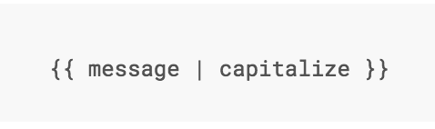
Filter
Notes:
Vue.js allows you to define filters that can be used to apply common text formatting.

Slide 44
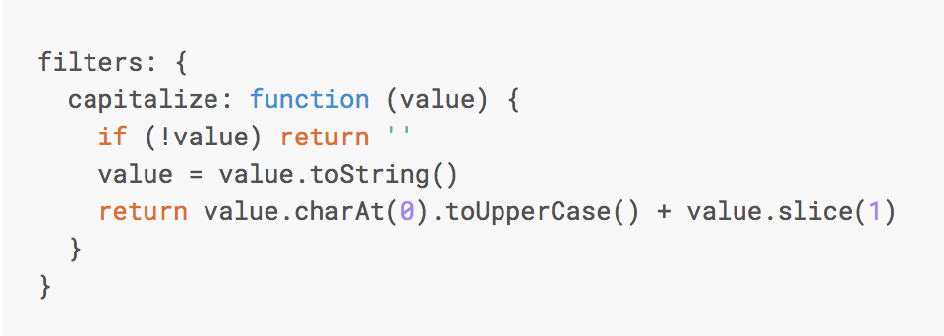
Custom Filter
Notes:
You can define local filters in a component’s options:

Slide 45
TODO
Uitleg component
Uitleg data binding + 2 way databinding
@onBlur @onclick @onfocus. OF :onClick
Name, Props, data(), Methods, Computed() in Child components
Start app with root Vue: new Vue()
Computed properties en watchers

Slide 46
DIRECTIVES
Notes:
Directives are special attributes with the v- prefix. Directive attribute values are expected to be a single JavaScript expression (with the exception of v-for, which will be discussed later). A directive’s job is to reactively apply side effects to the DOM when the value of its expression changes.

Slide 47
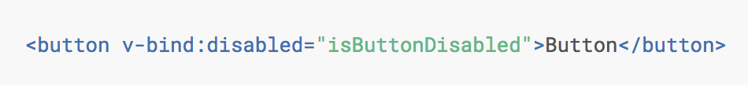
v-bind
Notes:
If isButtonDisabled has the value of null, undefined, or false, the disabled attribute will not even be included in the rendered <button> element.

Slide 48
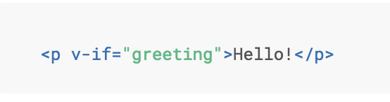
Directive v-if
Notes:
Here, the v-if directive would remove/insert the <p> element based on the truthiness of the value of the expression greeting.

Slide 49
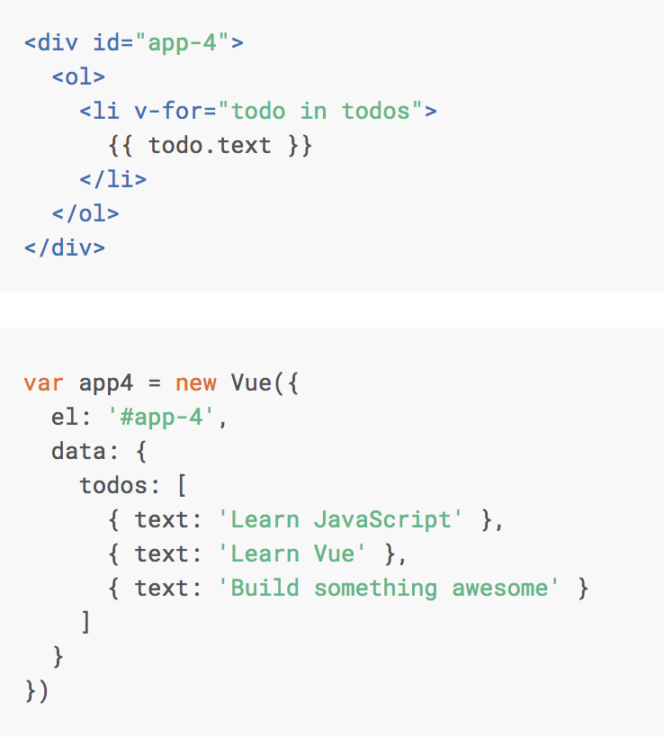
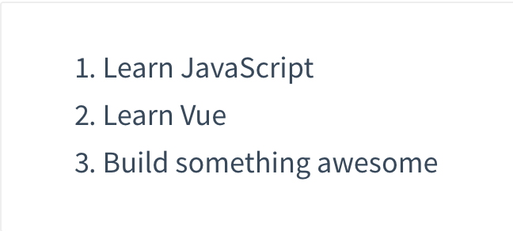
Directive v-for

Slide 50
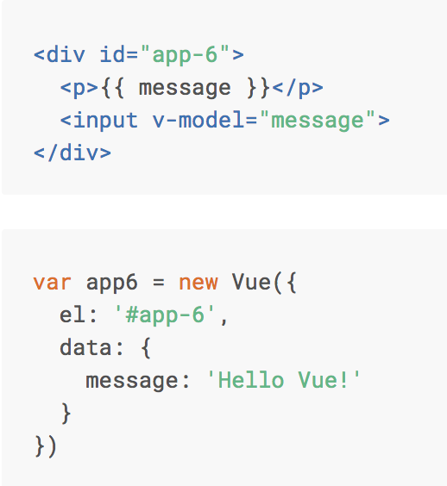
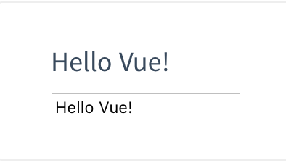
Directive v-model

Slide 51
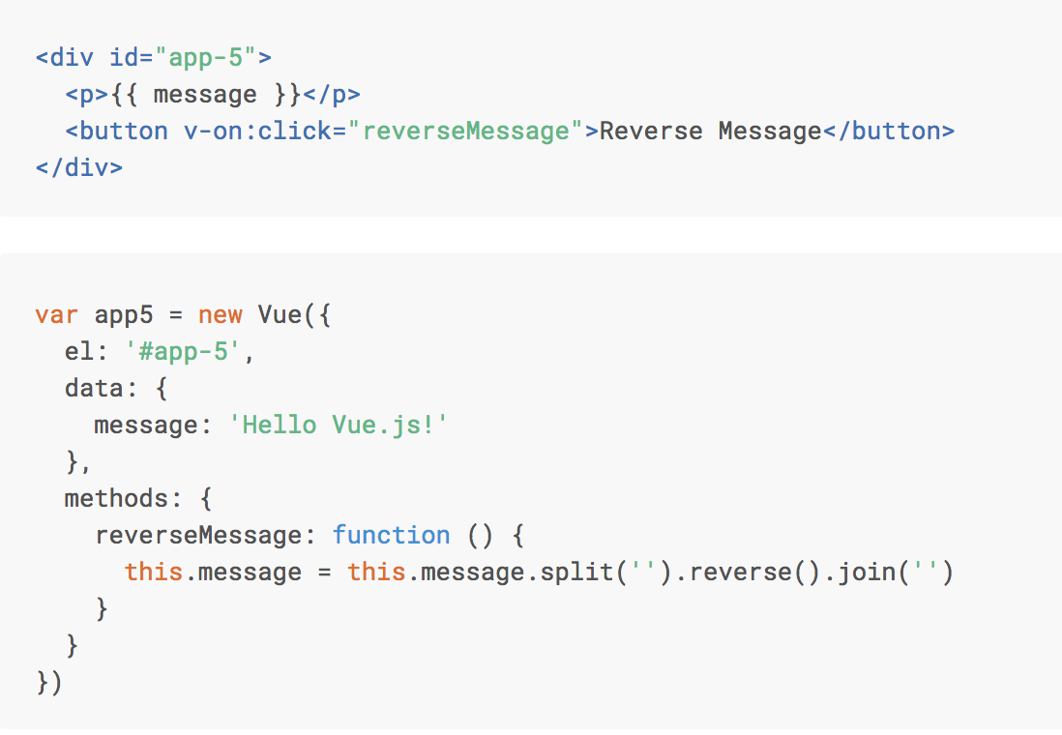
Directive v-on:click

Slide 52
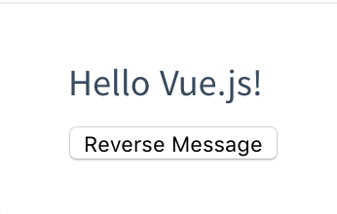
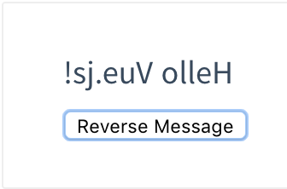
Directive v-on:click

Slide 53
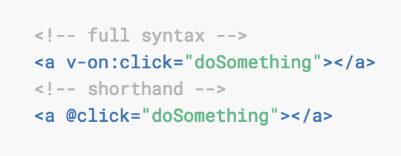
v-on:click Shorthand

Slide 54
@blur.stop.prevent

